Slide 1
Agency Prepayment: Default
March 2016

Slide 2
Model Update Overview 1. Data Set
Model v1
Calibrated on
Loan Level
For:
Conventional
From:
1999
Purpose of Default Model
Track and predict default speed on:
Pool Level
For:
Conventional
Jumbo
CQ/CR
Model v3
Calibrated on
Pool Level
For:
Conventional
Jumbo
CQ/CR
From:
2011
Longer history | Strengths | Pool level model for pool level tracking Calibrated on Jumbo, CQ/CR
Using loan level model to calculate pool level default Not calibrated to Jumbo, CQ/CR data set | Weaknesses | Limited historical data

Slide 3
Model Update Overview 2. Streamline Model Parameters
Default model V1
Changes
2
1. Add plausible long-range forecast : Months Since Starting Payment Status
Sub-models
For each starting payment status (current/delinq),we build a curve to show how default rates evolve over time.
Model for current loans
Model for delinquent loans
2. Remove occupancy parameter
4
Based on our fits, Occupancy status is not significant for the pool level default data set.
Parameters
3. Add Credit Availability parameter
CLTV
FICO
WALA
Occupancy
When there is more credit availability (CA), it tends to be easier for borrowers to refinance instead of default. Regression results support a negative correlation between CA and the default rate.
4. Remove adjustment functions
2
The old model involved tweaks because we used loan level data to calibrate the model and then used these adjustment factors to fit pool level data
Adjustment Functions
Tweaks for CLTV, WALA
Decay function for CLTV, WALA
5. Add constraints for extrapolation
Using cap and floors for out of range extrapolation. Make sure the tail performance is reasonable.

Slide 4
Model Update Overview 2. Streamline Model Parameters
Default model v1
Default model v3
2
2
Sub-models
Sub-models
Model for current loans
Model for delinquent loans
CDR = Current% * Model_CurrentLoans
+ Delinq% * Model_DelqLoans
4
5
Parameters
Parameters
CLTV
FICO
WALA
Occupancy
MonthSinceStartingPaymentStatus
CLTV
Credit Availability
FICO
WALA
2
1
Adjustment Functions
Constraint
Tweaks for CLTV, WALA
Decay function for CLTV, WALA
Constraints for extrapolation

Slide 5
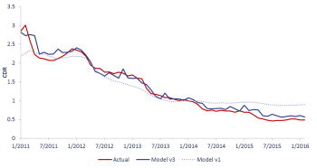
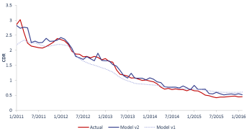
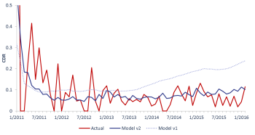
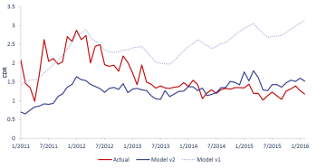
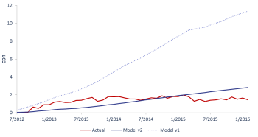
Performance Comparison 1. Overall
Model Tracking Performance – Overall (Conventional + Jumbo + CQ/CR)
Overall
Conventional
Jumbo
CQ
Model v3 has better performance in two areas:
For the most recent 2 years, model v1 is too fast, while v3 has better tracking
Model v3 is better at capturing the peak default rate (in pool level data) in 2011.
CR

Slide 6
Performance Comparison 2. Conventional
Model Tracking Performance – Conventional
Overall
Conventional
Jumbo
CQ
Both of the two models have good performance for conventional (CL) pools.
The tracking error for model v3 is lower, especially for the most recent two years.
CR

Slide 7
Performance Comparison 3. Jumbo
Model Tracking Performance – Jumbo
Overall
Conventional
Jumbo
CQ
Both of the two models have a good performance for conventional Jumbo pools .
The tracking error for model v3 is lower.
CR

Slide 8
Performance Comparison 4. CQ
Model Tracking Performance – CQ
Overall
Conventional
Jumbo
CQ
For CQ pools, both of the models are too fast after 2014, but model v3 is closer to actual prepayment speeds in that period. However, Model v1 displays better performance in 2011/2012.
CR

Slide 9
Performance Comparison 5. CR
Model Tracking Performance – CR
Overall
Conventional
Jumbo
CQ
Model v3 has a much better performance on CR pools compared with v1. Some of the underperformance by v1 is an artefact of the fact that significant extrapolation was necessary given that v1 was only fitted on CL loans.
CR

Slide 10
Performance Comparison 6. MHA

Slide 11
Performance Comparison 6. Extending the Historical Data Set
Model Tracking Performance – Historical
Loan Level Actual
Pool Level Actual
In order to examine model results for further back in history, we complement the pool-level data set with loan level default data (each loan is treated as a distinct pool by the pool-level model). Results show that even though we only use data from 2011 onwards to calibrate the default model, the v3 model modestly underperforms v1 for the out-of-sample historical period ranging from 1999 to 2011. And, for tracking from 2011 to 2016, v3 shows its strength.

Slide 12
Performance Comparison 7. Tracking Long-Range Forecasts
Model Tracking Performance – Full Historical (For all existing pools as of 2012/05)
Based on a sample of all pools that exist as of 2012-05 (CQ, CR, CL etc.), we simulate the “out-of-sample” tracking power of the MonthsSinceLastPaymentStatus curve. The model’s forecasts for all months subsequent to 2012-05 are based on updated collateral/market conditions (HPA 2-year, WALA, CLTV) but only rely on the initial payment status of the relevant pools as of 2012-05.

Slide 13
v3 Default Model Details 1. Model Multipliers
01
Month since current / delinq status helps to predict the long term evolution of pool default rates
v3 of the default model includes the five prediction parameters listed on the left-hand side.
Sequentially fitting model with the five parameters, we can create a cubic spline curve for each one of these inputs.
The parameter ordering is based on a single parameter regression calculated R-square value.
Parameters that have earlier order will have more significant impact on our model out put.
Month Since Start
02
Borrower with higher CLTVs will have a higher risk of default.
CLTV
03
When credit availability goes higher, borrowers will have a better chance to refinance lowers the default rate.
Credit Availability
04
Borrowers with lower FICO scores have higher risk of default.
FICO
05
The WALA ramp effect shows a increasing trend of default as loan age goes up.
WALA

Slide 14
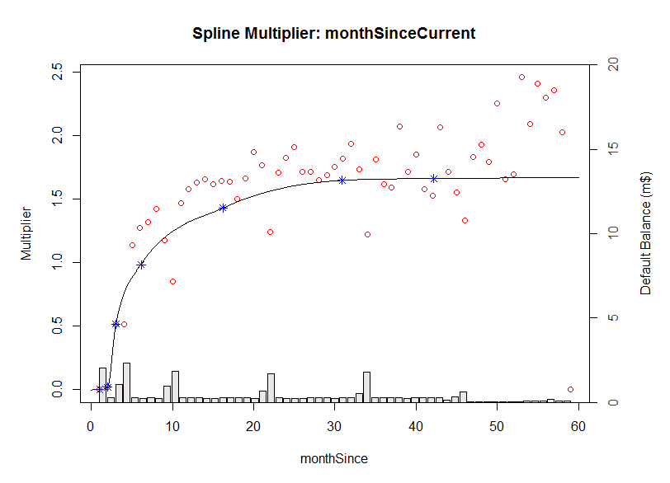
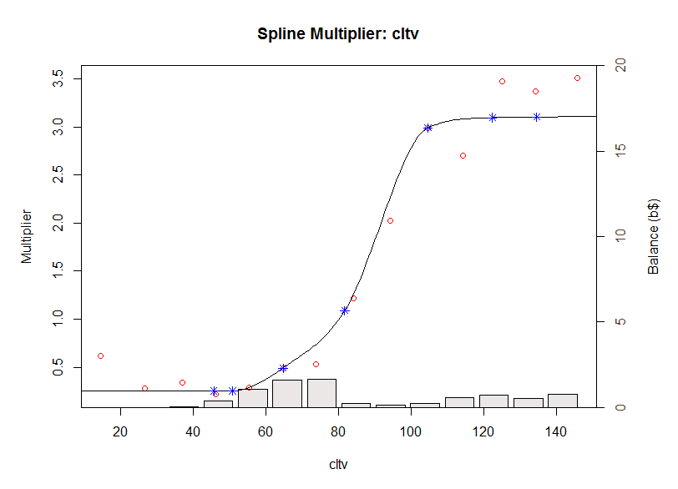
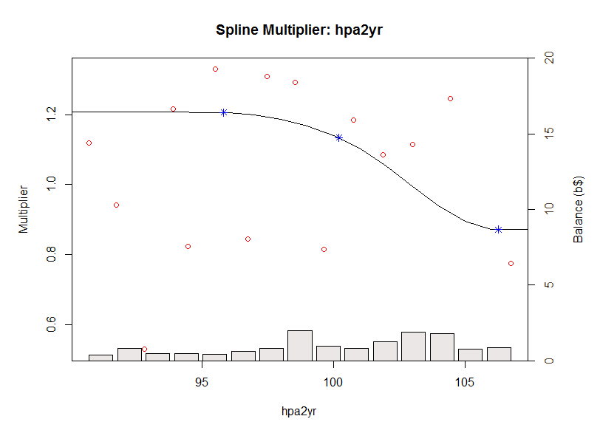
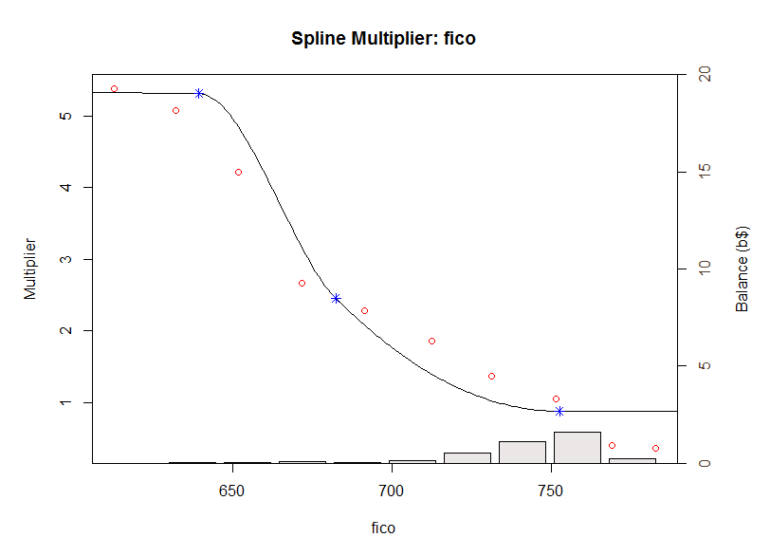
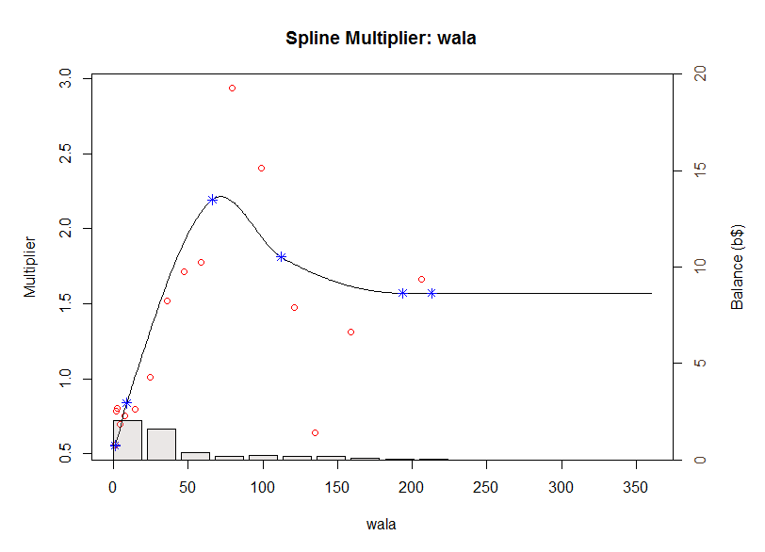
v3 Default Model Details 2. Model Multiplier Splines - Current

Slide 15
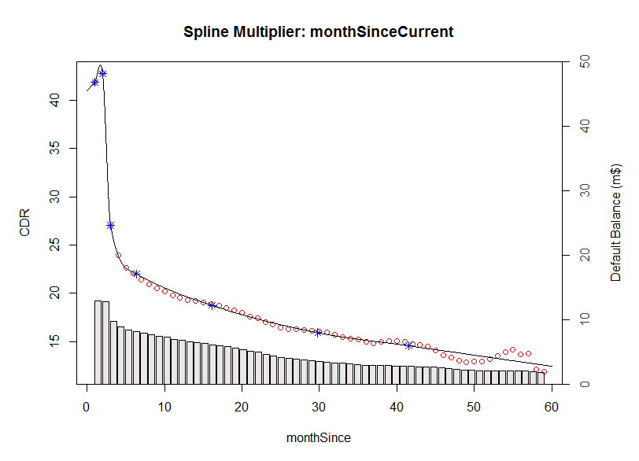
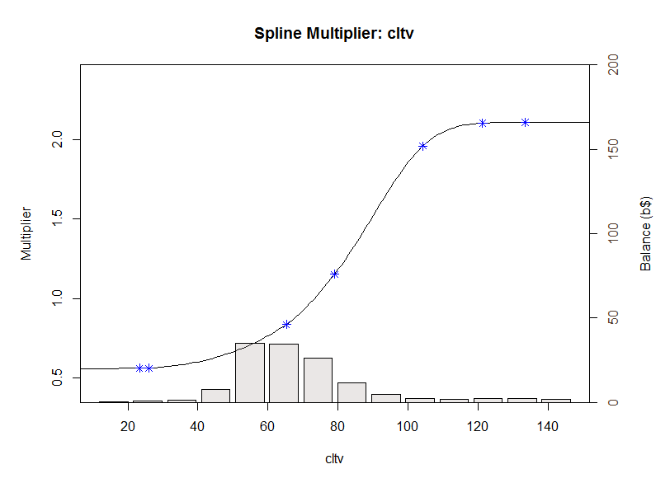
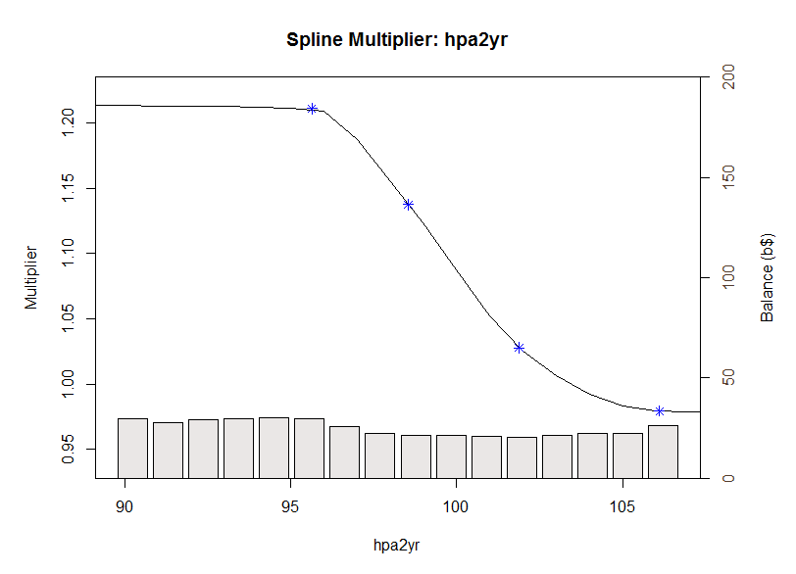
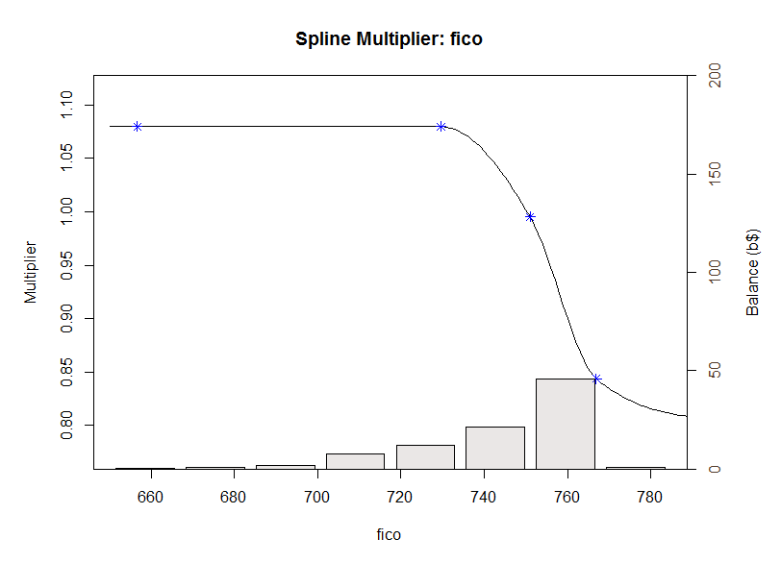
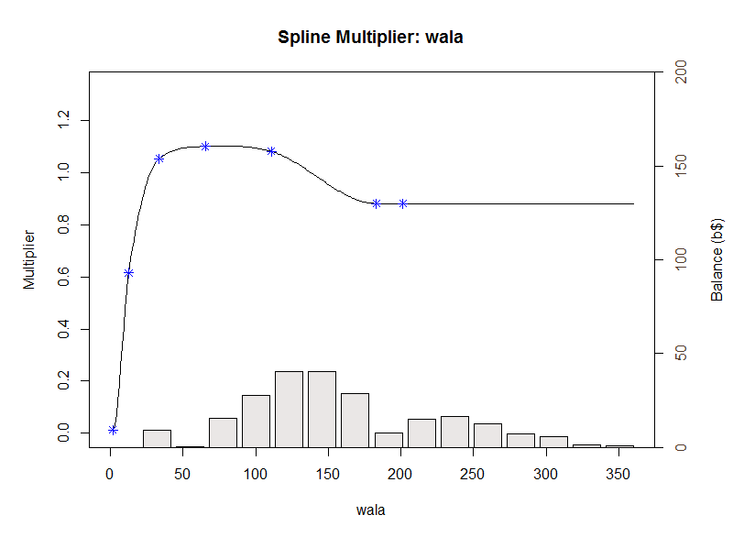
v3 Default Model Details 2. Model Multiplier Splines - Delinquent

Slide 16
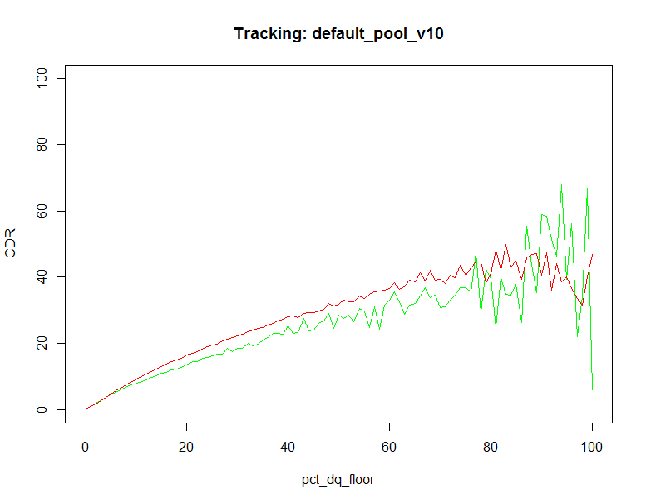
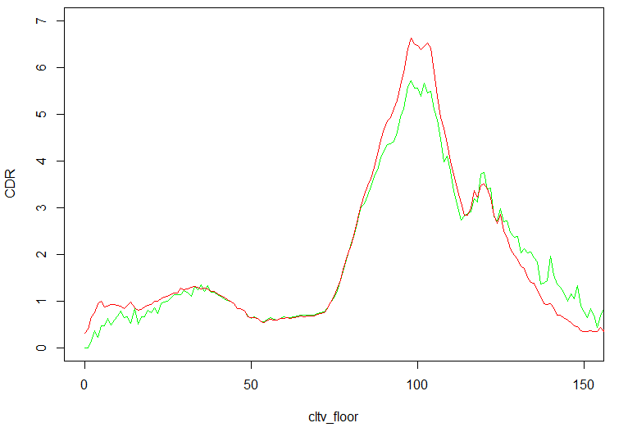
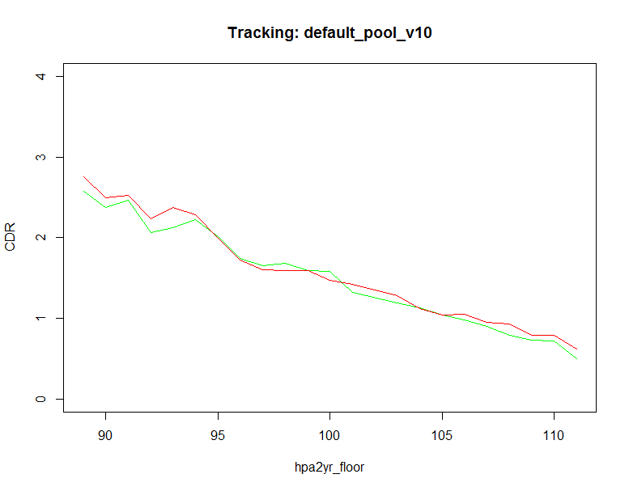
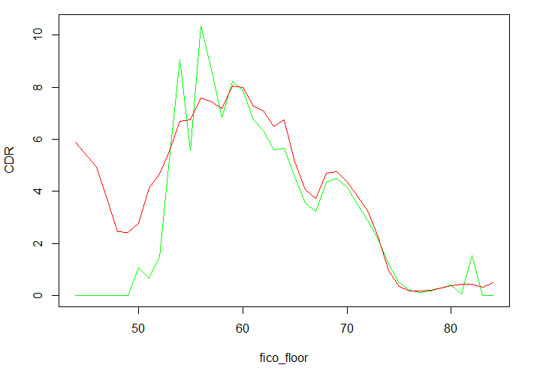
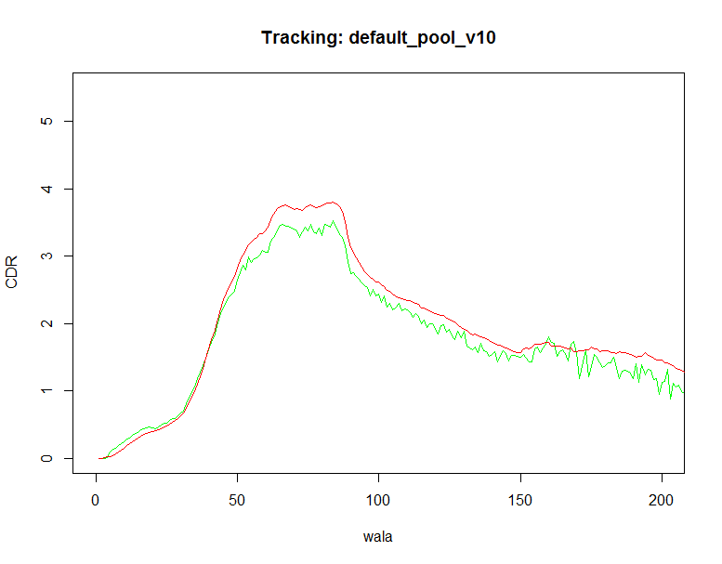
v3 Default Model Details 3. Model Multiplier Tracking
Delinq Percentage
CLTV
Credit Availability
FICO
WALA
Actual
Model

Slide 17
Appendix 1. Max Value of Multipliers
100% Delinquent Pools
 | Min | Max
baselineConstant | 44.29 | 44.29
cltv | 0.56 | 2.11
hpa2yr | 0.98 | 1.21
fico | 0.80 | 1.08
wala | 0.00 | 1.10
Default (%CPR) | 0.000 | 84.8

Slide 18
Appendix 2. Data Statistics
Description of Default Data
Prepay Data
Pool Level
Delinquency/Default information only available for Freddie pools
~ 352 K pools with data as far back as 2011
30 Day, 60 Day, 90 Day, 120 Day and Repurchased balances are available. These are exclusive, not cumulative percentages. The 120Day Balance is usually 0 since the Agencies will removed 120 Day delinquent loans from the pool but there are exceptions (see next slide)
The Delinq% is the sum of the 30Day, 60Day, 90Day and 120Day balances.
Loan Level
No Delinquency/Default information is available
Credit Data
Delinquency/Default information available for Fannie and Freddie loans
~ 40 M loans with data as far back as 1999
Loan Age up to 180
Has indicators for Prepayment, and Default
Excellent coverage for FICO, DTI, CLTV (msa level), Occupancy, etc.

Slide 19
Description of Default Data: Default Definition
Appendix 3. Default Definition
Prepay Data
Pool Level: Default Definition
120 day delinquent loans are usually removed from the pool. From 2009-2011, the Agencies did not repurchase 120 day loans because they were suffering from funding issues.
Default balance is reported
Credit Data
Loan Level: Default Definition
180 day delinquent loans are removed from the data and a Zero Balance Code is reported
Revised Credit Data
We must modify the default criteria to match with the Pool data
First time a loan reaches 120 days delinquent, the loan is marked as a default
Default Empirical Formula
MDR (monthly default rate) = default balance / current balance

Slide 20
Appendix 4. Distribution of Default Rates
Pools demonstrate significant CDR variability

